Slide 1
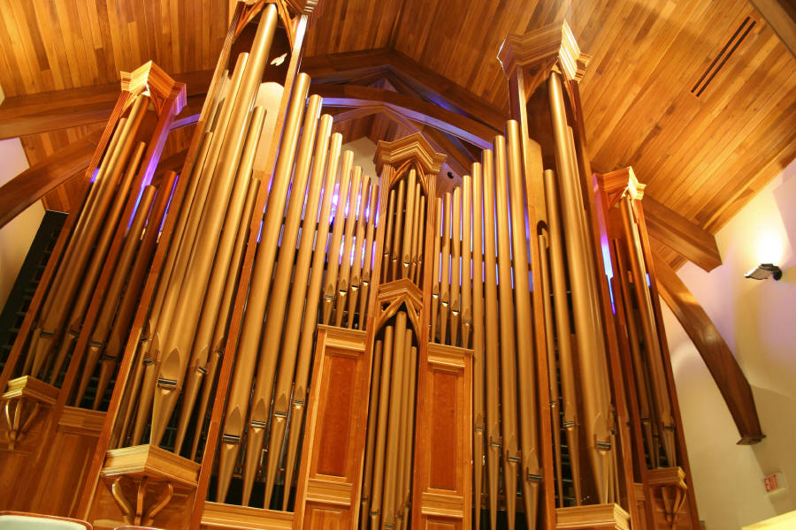
Air Column Resonance
This lesson will introduce you to how sound is created in air columns
You will also learn about the two types of air columns, open and closed ended

Slide 2
Learning Goals
By the end of this lesson, you will be able to:
explain acoustic resonance in air columns
draw air column resonance patterns
explain open and closed end air column resonance
solve problems involving open and closed air columns

Slide 3
Success Criteria
Can I:
explain acoustic resonance in air columns
draw air column resonance patterns
explain open and closed end air column resonance
solve problems involving open and closed air columns

Slide 4
Acoustic Resonance in air columns
Air columns can produce acoustic resonance (sound), by setting up a standing wave within the air column.
Both closed air columns, like pop bottles, and open air columns, such as a trumpet, can produce sound in this way.
In both types, the length of the column and the speed of sound determine the frequencies of the sounds produced by the air column.

Slide 5
Closed Air Columns
the shortest column length is known as the first resonant length
the next longest is called the second resonant length, etc.
For a closed air column, the first resonant length must be equal to ¼ λ.
subsequent resonant lengths can be determined by adding half wavelengths to the first resonant length.

Slide 6
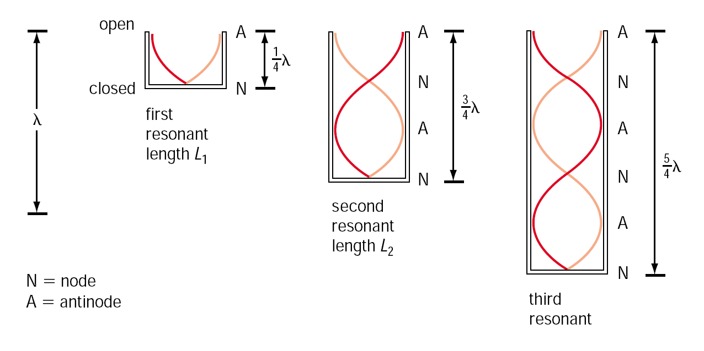

Slide 7
So, for the fundamental, the column length must be:
For the 1st overtone, the column length must be:
For the 2nd overtone, the column length must be:
etc …

Slide 8
Open Air Columns
for a open air column, the first resonant length must be equal to ½ λ.
Subsequent resonant lengths can be determined by adding half wavelengths to the first resonant length.

Slide 9
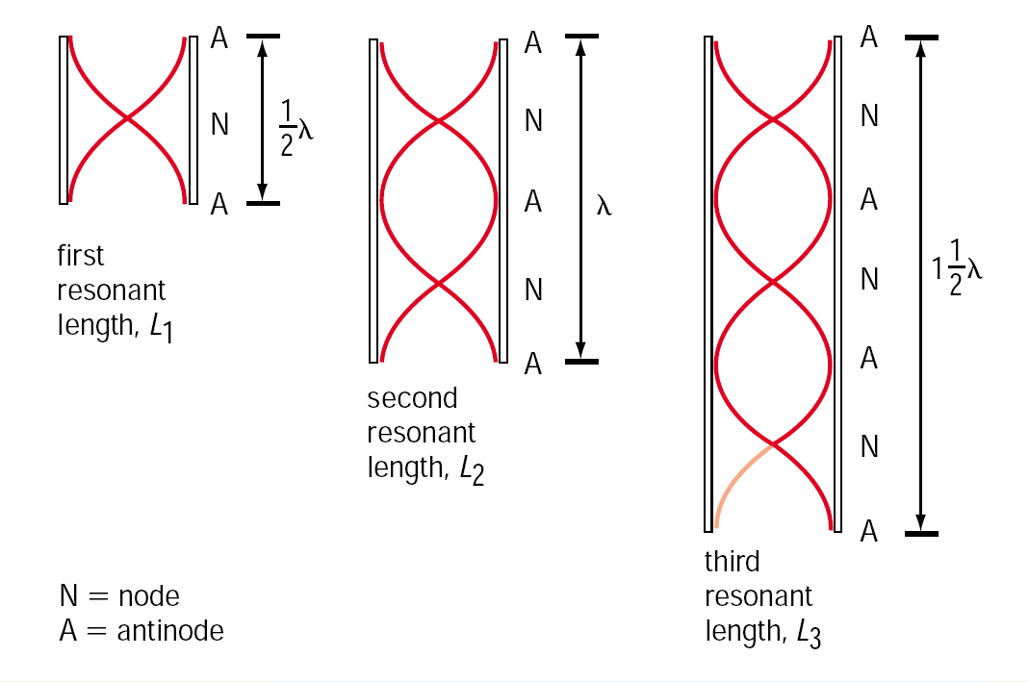

Slide 10
So, for the fundamental, the column length must be:
For the 1st overtone, the column length must be:
For the 2nd overtone, the column length must be:
etc …

Slide 11
Sample Problem
A tuning fork with a frequency of 384 Hz is held above a closed air column. As the column is lengthened, it begins to resonant at a length of 67.5 cm. What is the most likely wavelength for the sound wave?
Sol’n:
We start by assuming the 67.5 cm is the
1st resonant length
f = 384 Hz
λ = ?

Slide 12
Using the wave eqn:
this v is too fast
Next we assume the 67.5 cm is the 2nd resonant length

Slide 13
Using the wave eqn:
this is right
∴ The most likely value for the wavelength is 0.900 m

Slide 14
HOMEWORK
Read Sections 10.3
Worksheet: http://sdrv.ms/1874PcD

